Slide 1
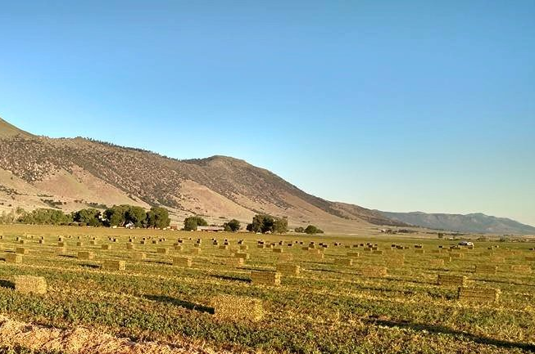
Is there potential for California alfalfa production to be climate neutral?
Gina Nichols¹, Dan Putnam¹, Cameron Pittelkow¹
¹University of California, Davis
https://garrodfarms.com/bird-flat-ranch/
International Symposium on Sustainable Systems and Technology – ISSST 2023
June 2023, Ft. Collins CO

Slide 2
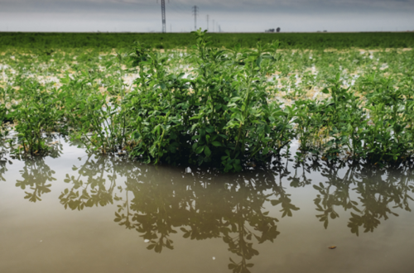

Slide 3
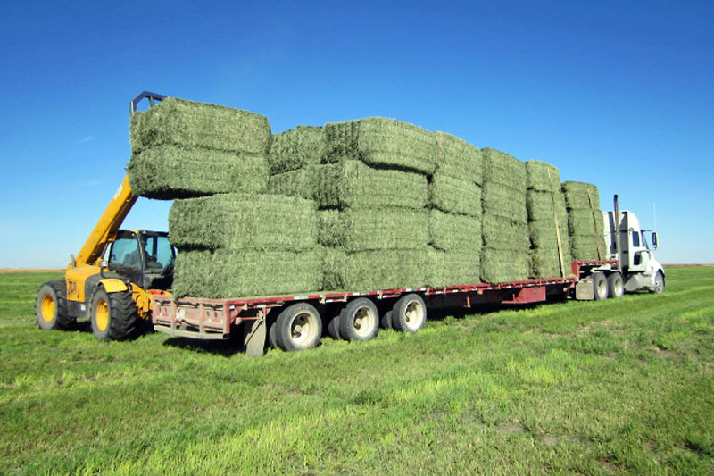
https://www.beeculture.com/catch-the-buzz-dairy-alfalfa-doesnt-get-to-bloom-but-beef-alfalfa-does-where-to-put-your-bees-is-simple/

Slide 4
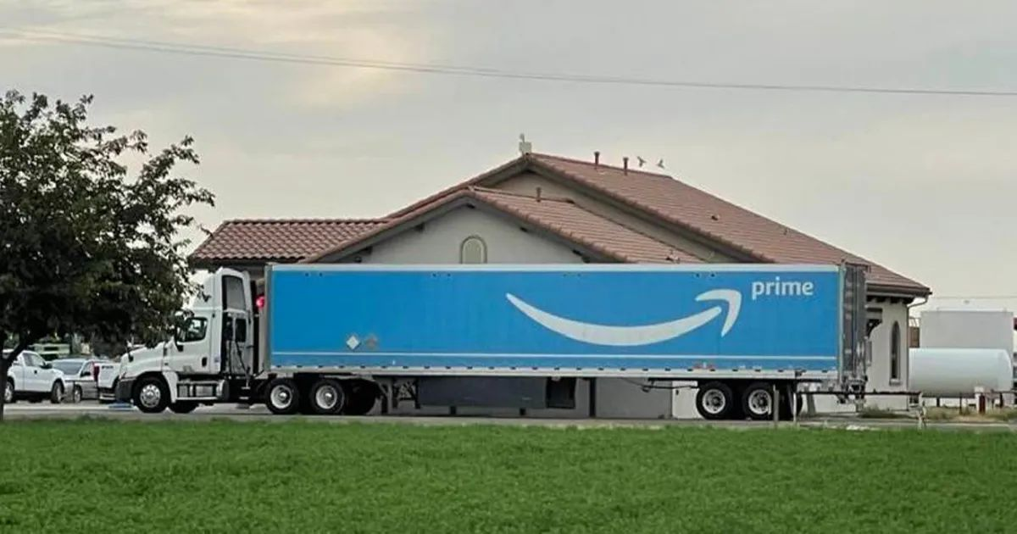
https://www.beeculture.com/catch-the-buzz-dairy-alfalfa-doesnt-get-to-bloom-but-beef-alfalfa-does-where-to-put-your-bees-is-simple/
https://westernagnetwork.com/premium-alfalfa-hay-delivered-by-amazon-prime

Slide 5
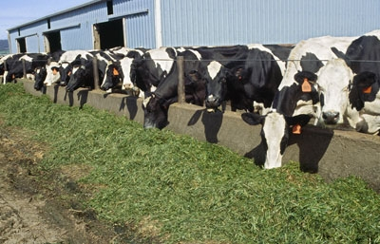
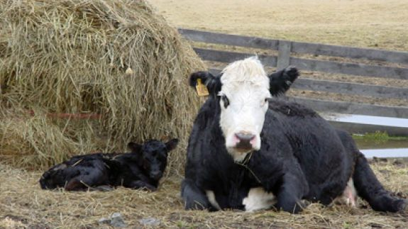

Slide 6
Narrow lens:
Not a great crop for California.

Slide 7
Narrow lens:
Not a great crop for California.
Broader lens:
Is that true?

Slide 8
Motivation
Methodology
Learnings

Slide 9
Motivation
Methodology
Learnings

Slide 10
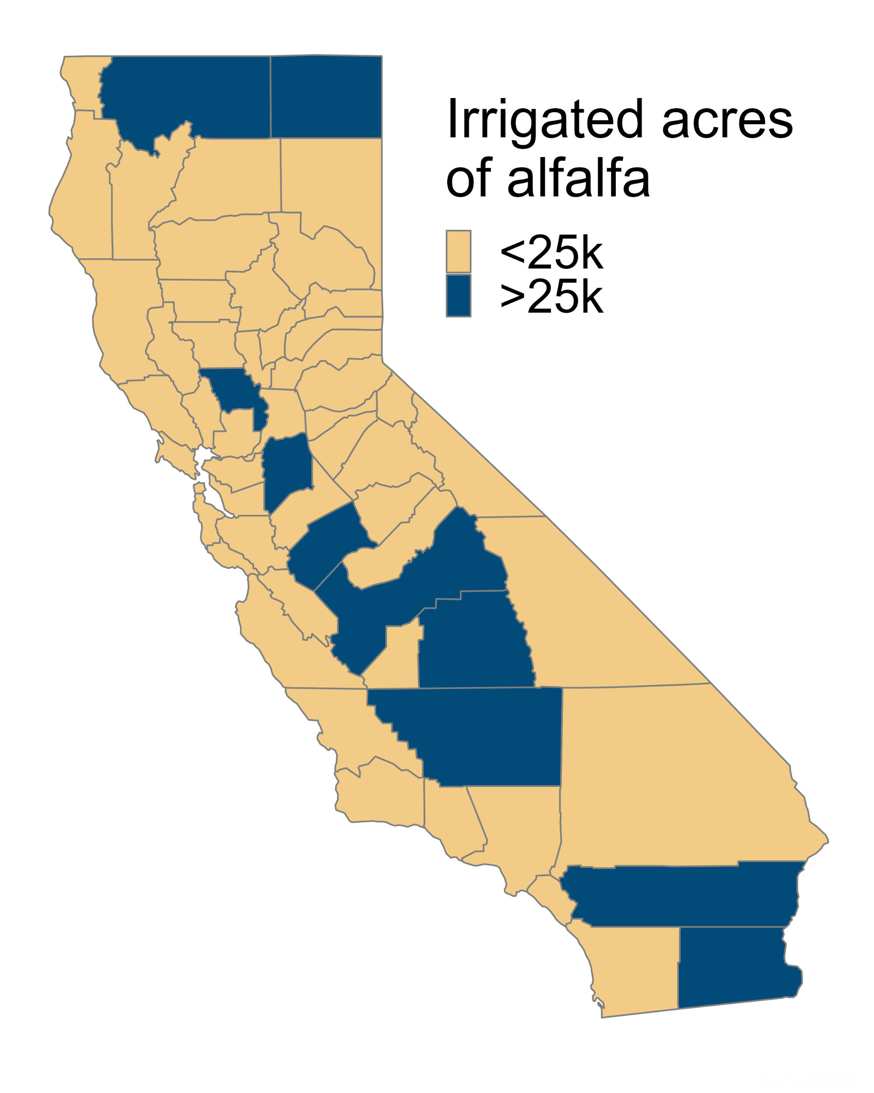
Motivation
Methodology
Learnings
Notes:
Environment includes water for ‘wild and scenic rivers’, required delta outflow, instream flows, managed wetlands. Ag includes water for crop production

Slide 11
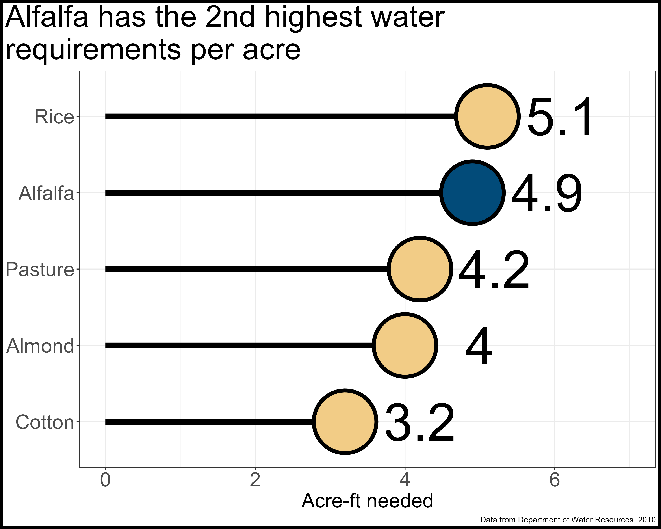
Motivation
Methodology
Learnings
Notes:
Environment includes water for ‘wild and scenic rivers’, required delta outflow, instream flows, managed wetlands. Ag includes water for crop production

Slide 12
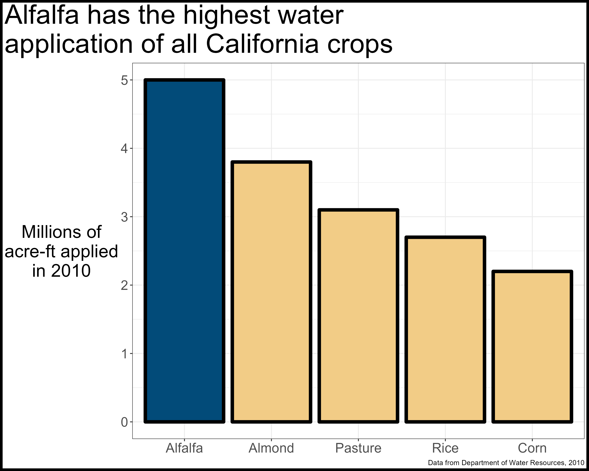
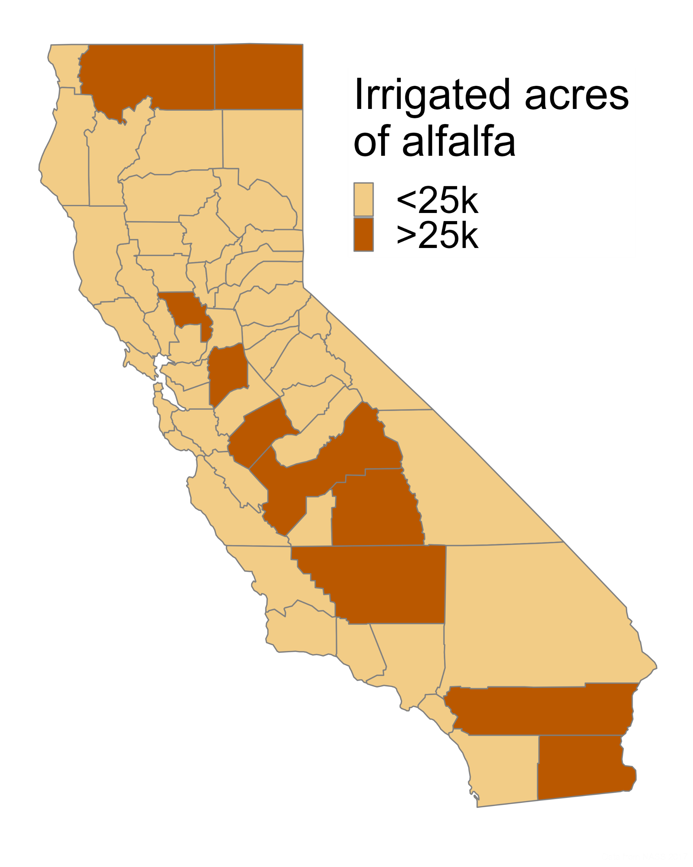
Motivation
Methodology
Learnings
Notes:
Environment includes water for ‘wild and scenic rivers’, required delta outflow, instream flows, managed wetlands. Ag includes water for crop production

Slide 13
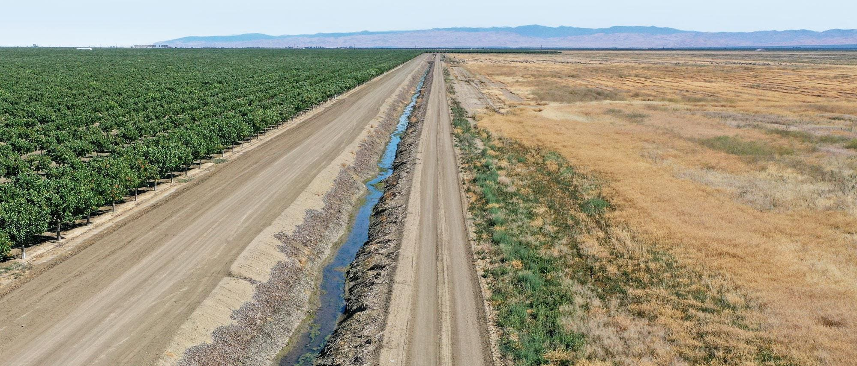
Motivation
Methodology
Learnings
https://www.forbes.com/sites/chloesorvino/2022/09/22/california-farms-pump-water-to-feed-crops-amid-extreme-heat-and-drought-but-residents-wells-are-running-dry/?sh=6550a2cd6eac

Slide 14

Motivation
Methodology
Learnings
One of the only wetland bird feeding areas left in California (Bray & Klebenow 1988)
Provides ‘free’ nitrogen to subsequent crop (Putnam & Pettygrove 2015)
Provides productive years without soil disturbance
Flexible water user (Montazar et al. 2020)

Slide 15

Motivation
Methodology
Learnings
Close proximity to dairies lowers transportation requirements
Lower yield variability compared to rainfed regions
Yields are consistently twice the US average

Slide 16
Motivation
Methodology
Learnings

Slide 17
Motivation
Methodology
Learnings
?

Slide 18
Use Life Cycle Assessment methodologies to estimate climate impacts of California alfalfa production
Motivation
Methodology
Learnings

Slide 19

Use Life Cycle Assessment methodologies to estimate climate impacts of California alfalfa production
Motivation
Methodology
Learnings

Slide 20
Use Life Cycle Assessment methodologies to estimate climate impacts of California alfalfa production
Motivation
Methodology
Learnings

Slide 21
Motivation
Methodology
Learnings
Functional unit:
1 hectare-year of land (carbon emissions)
1 Mg of dry yield (carbon efficiency)
System boundaries:
Cradle to roadside (~80% of alfalfa is sold)
Impact factors:
Piece together from publicly available sources
Flows:
Enterprise budgets

Slide 22
Motivation
Methodology
Learnings
Functional unit:
1 hectare-year of land (carbon emissions)
1 Mg of dry yield (carbon efficiency)
System boundaries:
Cradle to roadside (~80% of alfalfa is sold)
Impact factors:
Piece together from publicly available sources
Flows:
Enterprise budgets

Slide 23
Motivation
Methodology
Learnings
Functional unit:
1 hectare-year of land (carbon emissions)
1 Mg of dry yield (carbon efficiency)
System boundaries:
Cradle to roadside (~80% of alfalfa is sold)
Impact factors:
Piece together from publicly available sources
Flows:
Enterprise budgets

Slide 24
Motivation
Methodology
Learnings
Functional unit:
1 hectare-year of land (carbon emissions)
1 Mg of dry yield (carbon efficiency)
System boundaries:
Cradle to roadside (~80% of alfalfa is sold)
Impact factors:
Piece together from publicly available sources
Flows:
Enterprise budgets

Slide 25
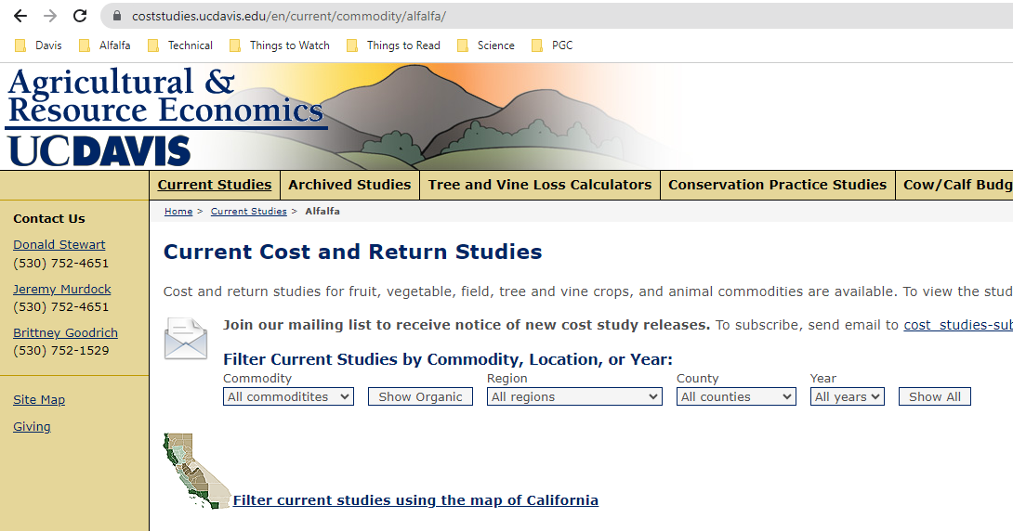
Motivation
Methodology
Learnings
https://coststudies.ucdavis.edu/en/current/commodity/alfalfa/

Slide 26

Motivation
Methodology
Learnings
http://comet-planner-cdfahsp.com/

Slide 27
Motivation
Methodology
Learnings
Functional unit:
1 hectare-year of land (carbon emissions)
1 Mg of dry yield (carbon efficiency)
System boundaries:
Cradle to roadside (~80% of alfalfa is sold)
Impact factors:
Piece together from publicly available sources
Flows:
Enterprise budgets, California Healthy Soils tool

Slide 28
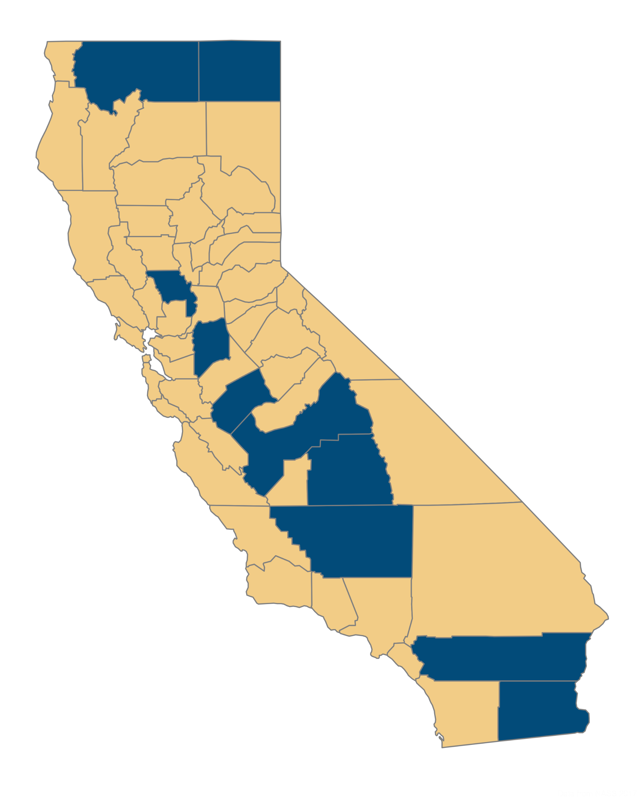
Motivation
Methodology
Learnings
Low input, low yields
Medium input, medium yields
High input, high yields

Slide 29
Motivation
Methodology
Learnings

Slide 30
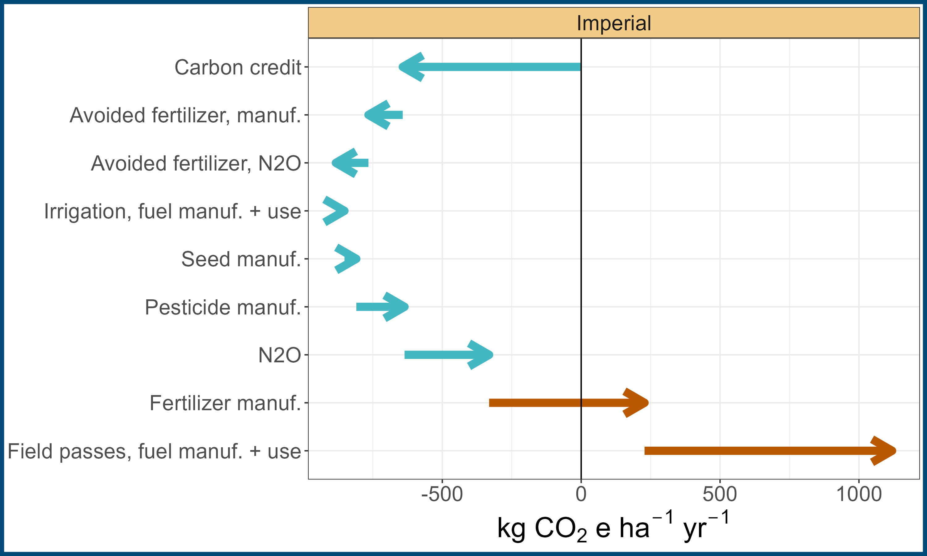
Motivation
Methodology
Learnings

Slide 31
Motivation
Methodology
Learnings
http://comet-planner-cdfahsp.com/

Slide 32
Motivation
Methodology
Learnings

Slide 33
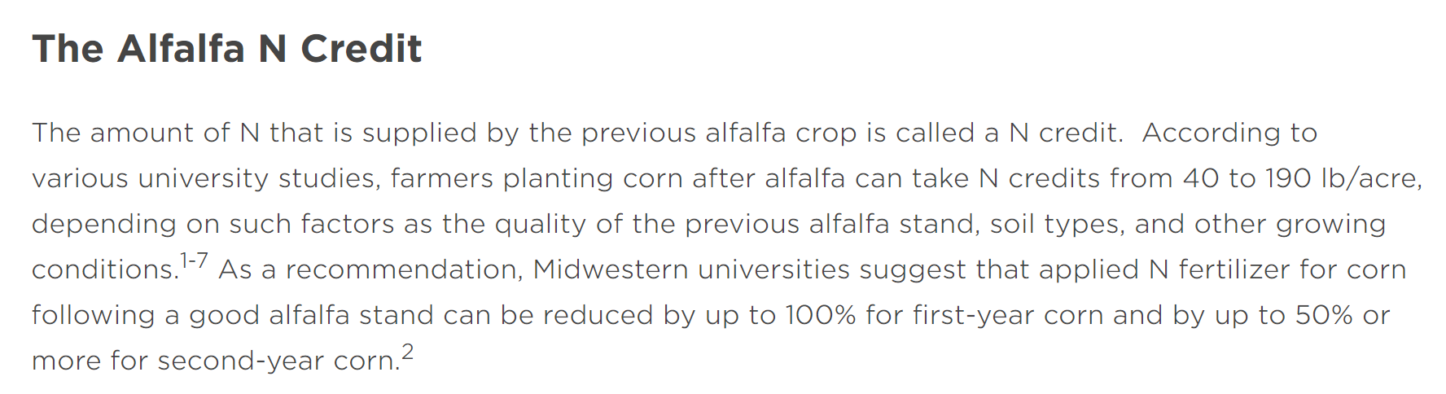





Fully account for cropping system impacts (Costa et al. 2020 Int J LCA)
https://www.channel.com/en-us/agronomy/determining_corn_fertilizer_requirements_following_an_alfalfa_crop.html

Slide 34
Motivation
Methodology
Learnings

Slide 35
Motivation
Methodology
Learnings

Slide 36
Motivation
Methodology
Learnings

Slide 37
Motivation
Methodology
Learnings

Slide 38
Motivation
Methodology
Learnings

Slide 39
Motivation
Methodology
Learnings

Slide 40
Motivation
Methodology
Learnings

Slide 41
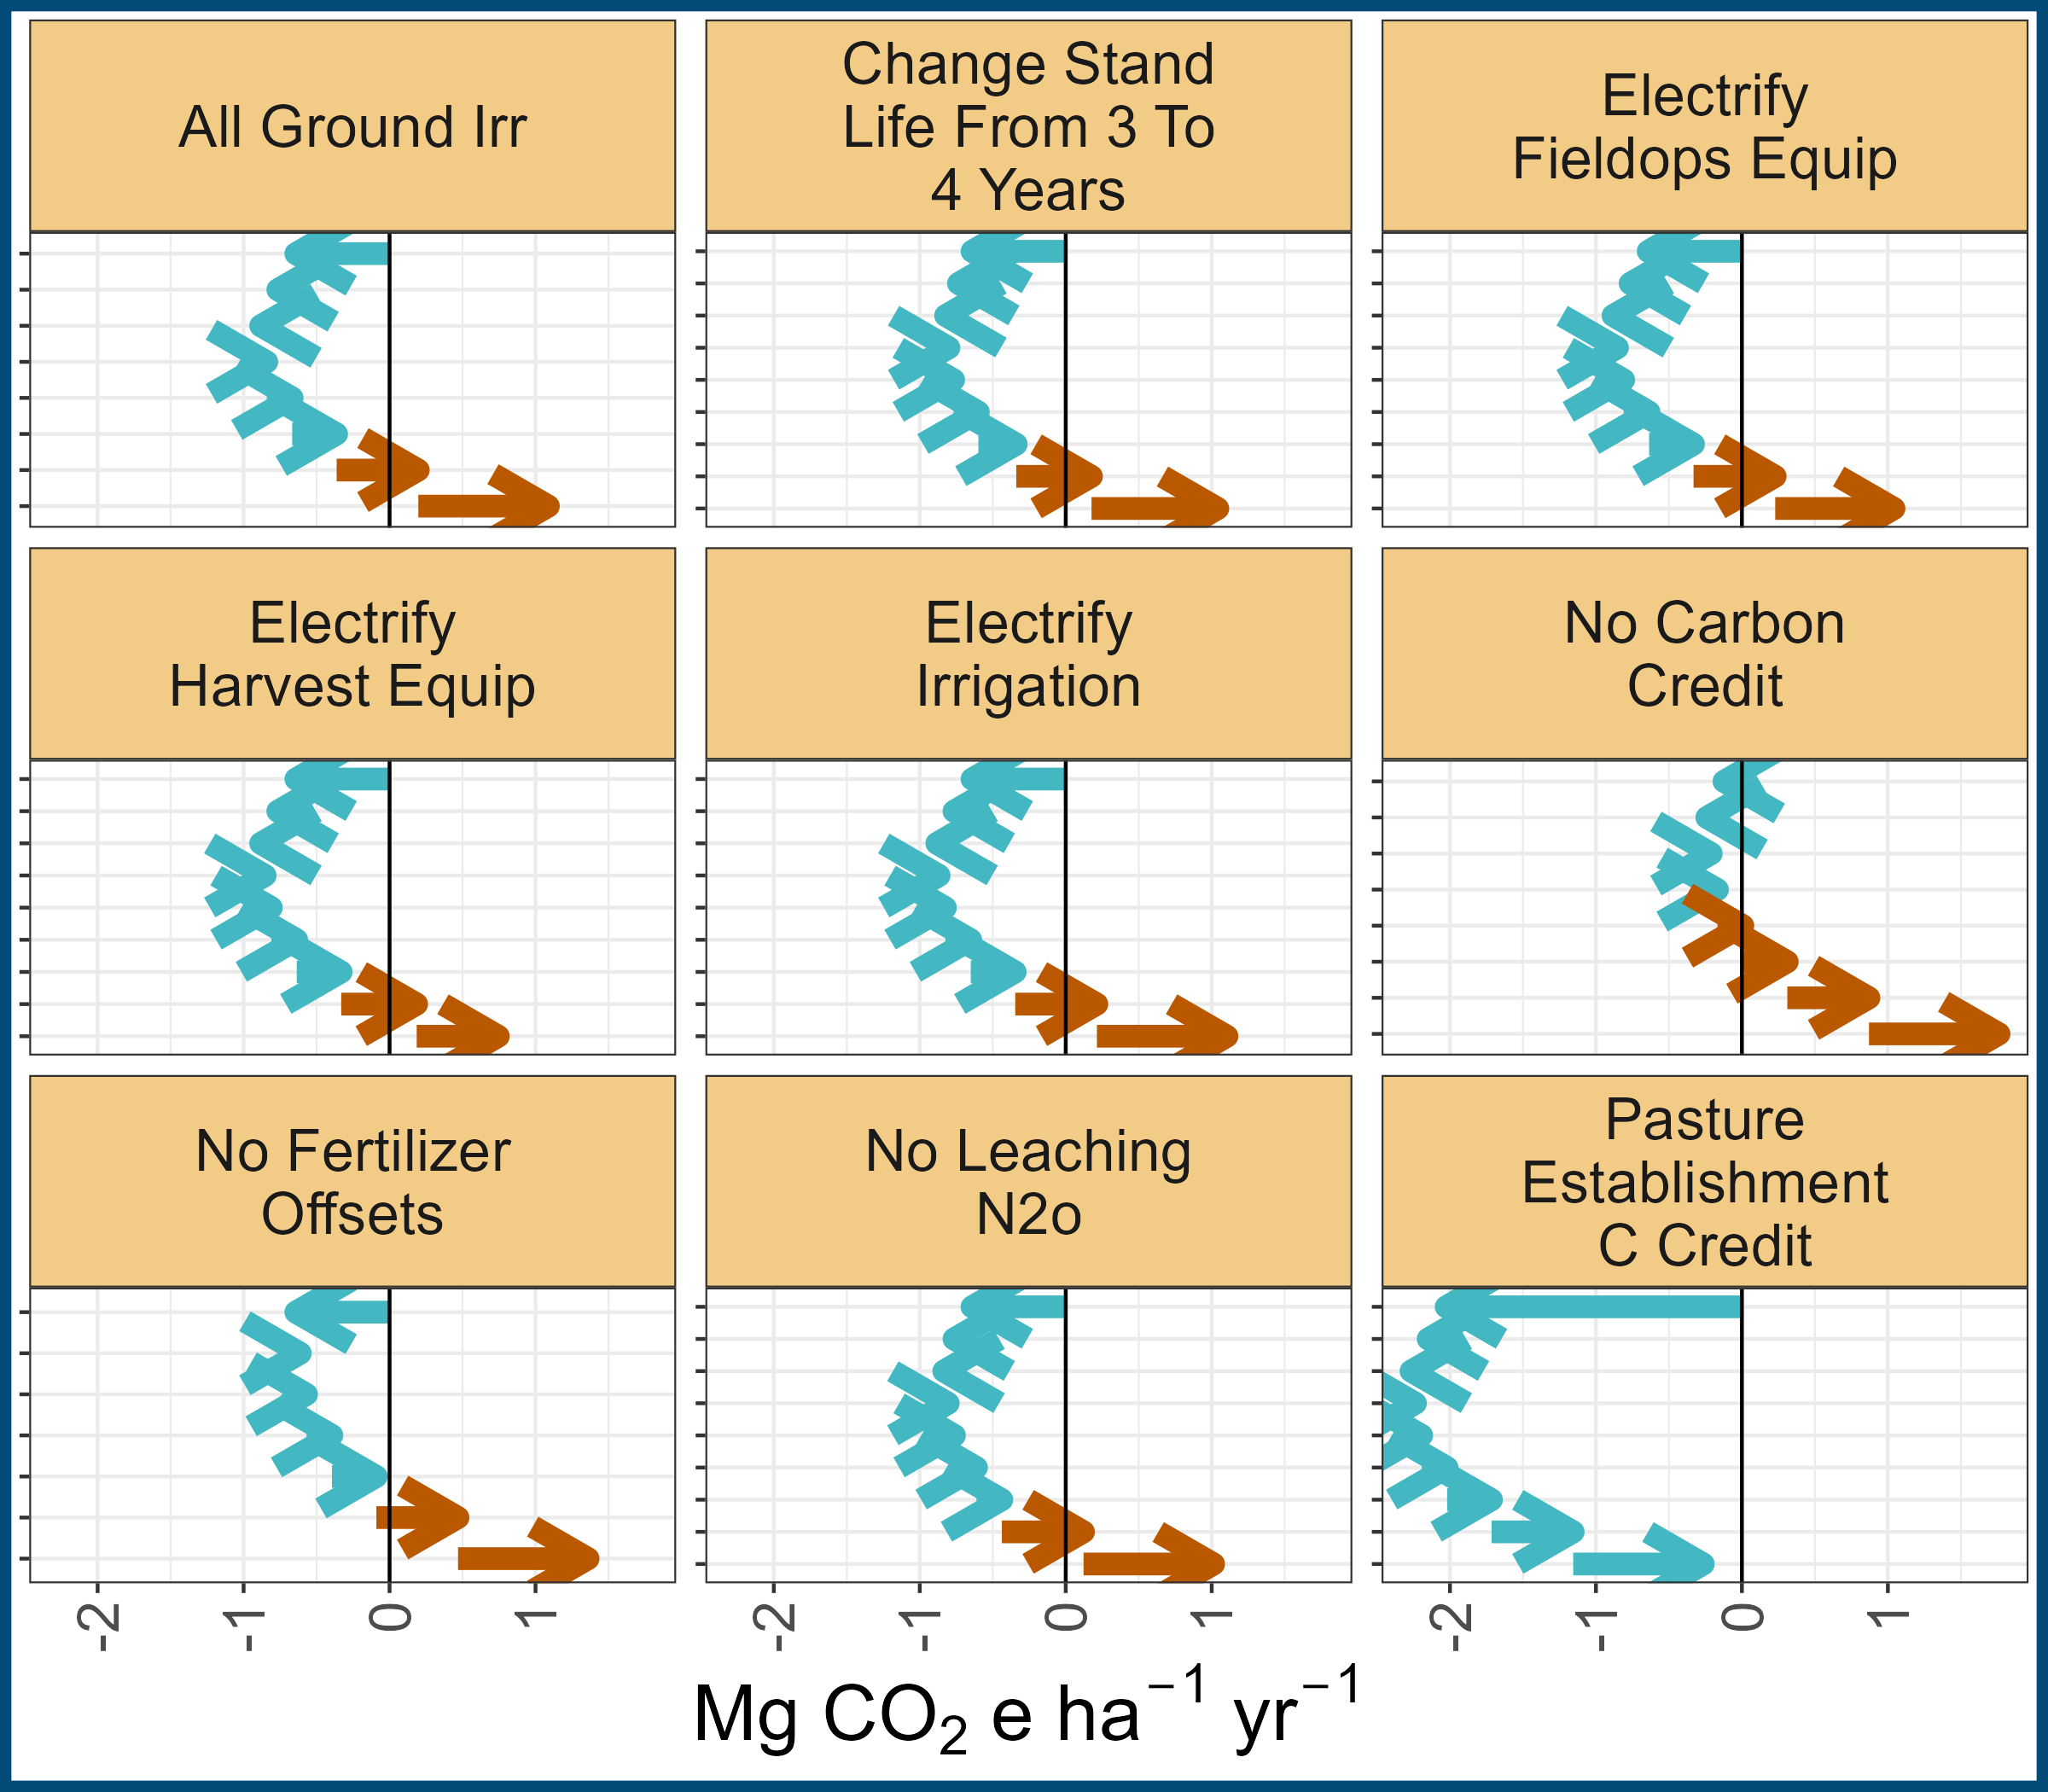
Motivation
Methodology
Learnings

Slide 42
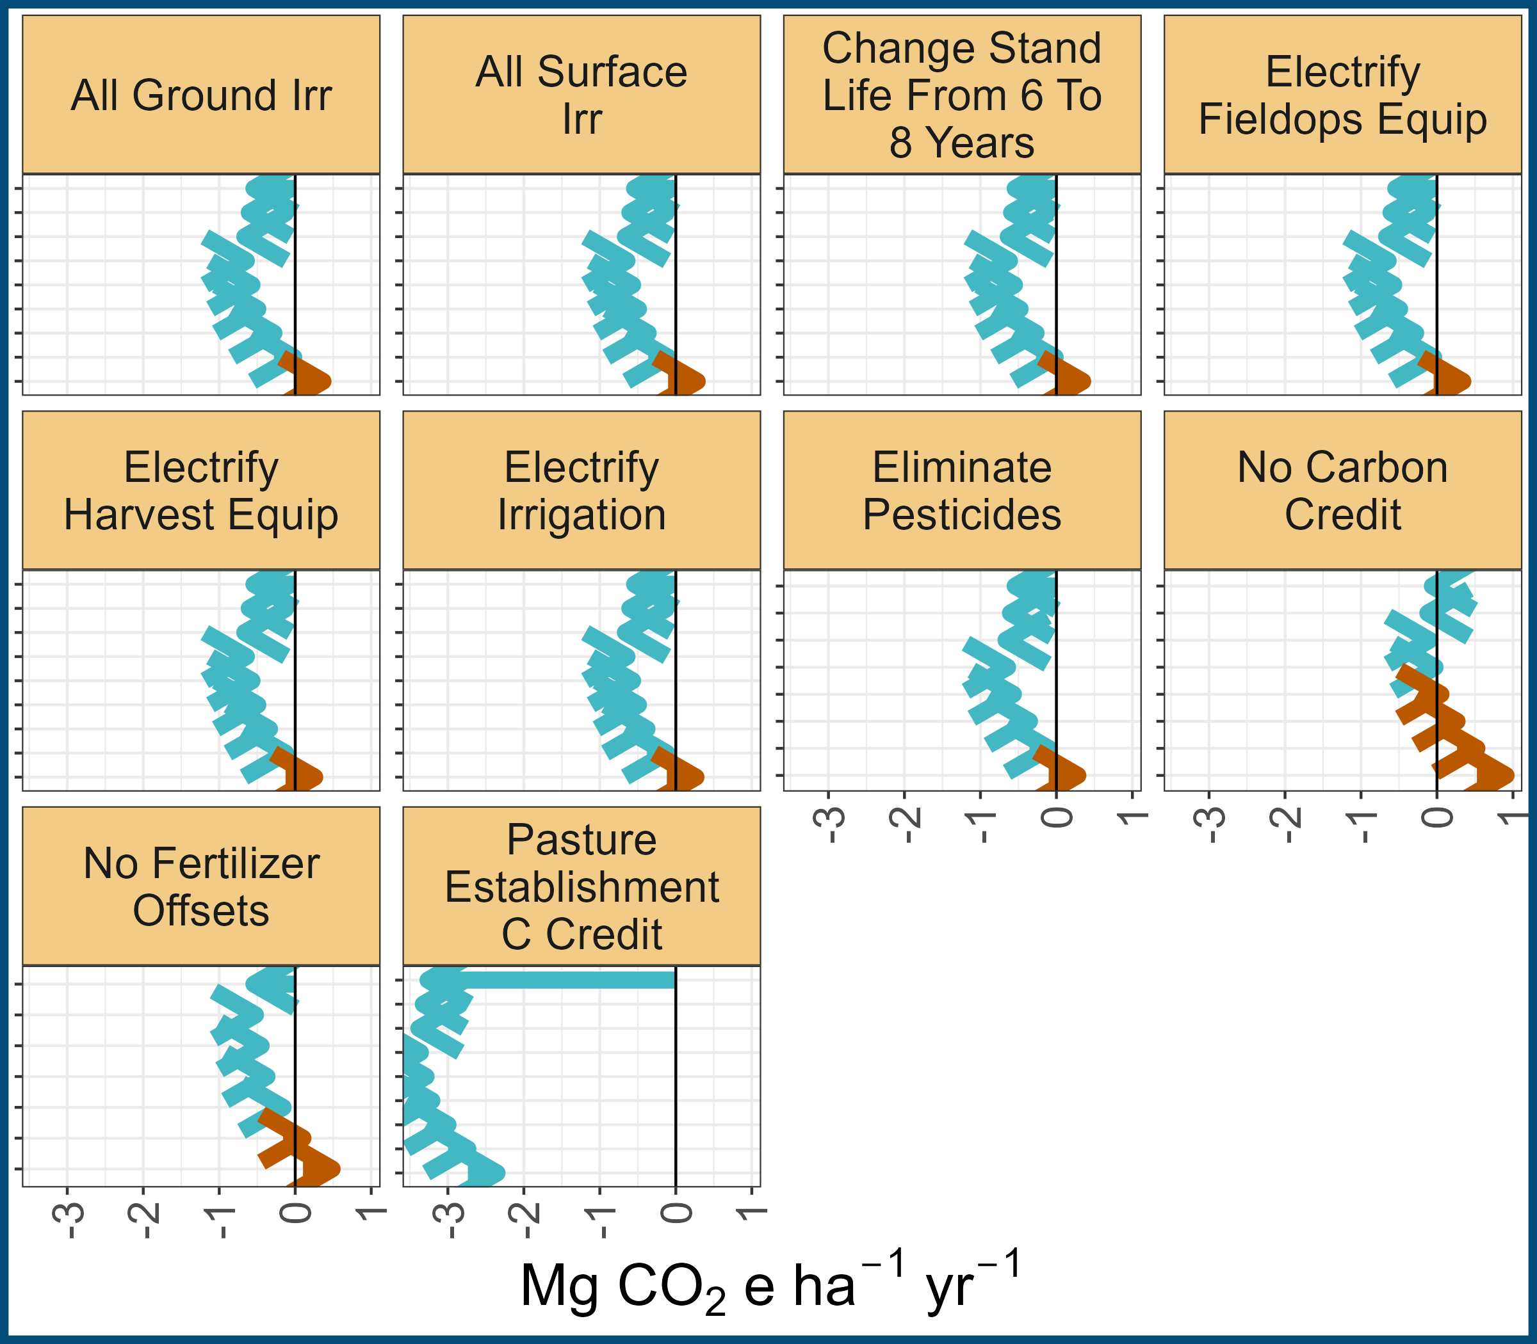
Motivation
Methodology
Learnings

Slide 43
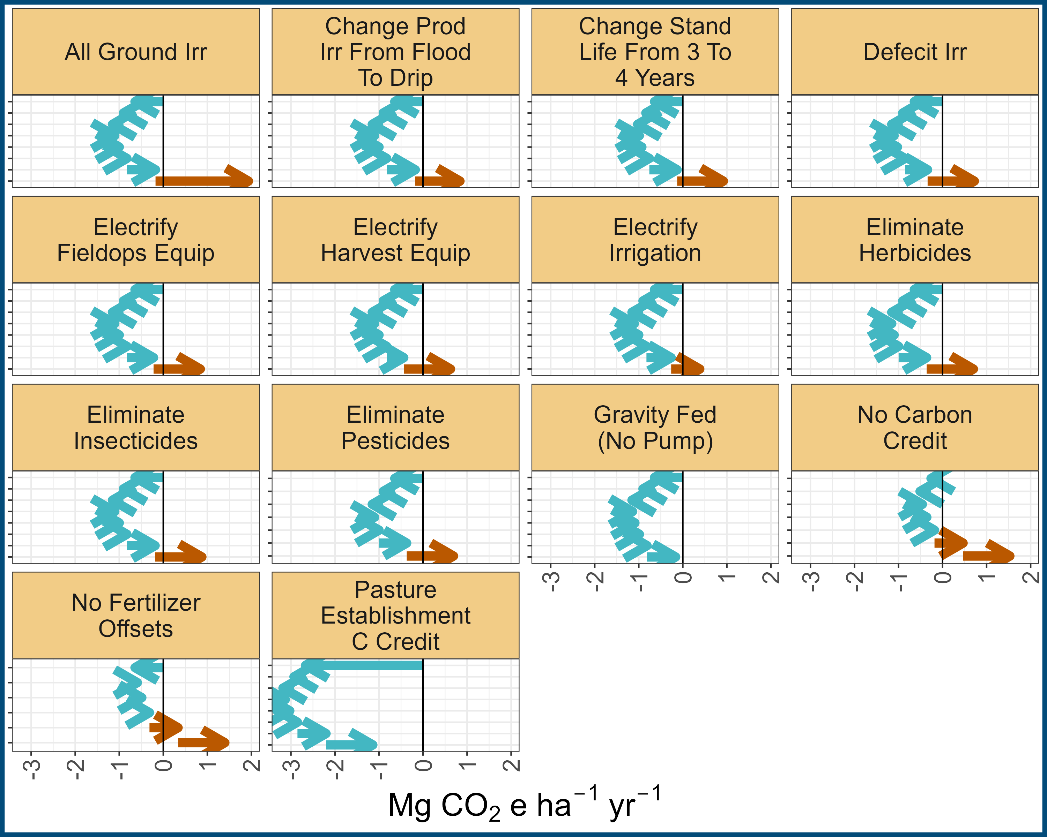
Motivation
Methodology
Learnings

Slide 44
Motivation
Methodology
Learnings

Slide 45
Motivation
Methodology
Learnings

Slide 46
Motivation
Methodology
Learnings
“It shall be the goal of the State to transition to 100% zero-emission off-road vehicles and equipment by 2035 where feasible.”
https://www.gov.ca.gov/2020/09/23/governor-newsom-announces-california-will-phase-out-gasoline-powered-cars-drastically-reduce-demand-for-fossil-fuel-in-californias-fight-against-climate-change/

Slide 47
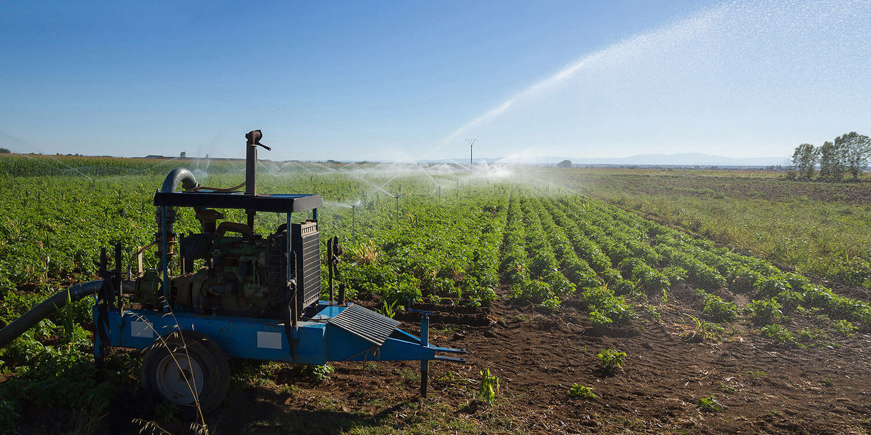
Motivation
Methodology
Learnings

Slide 48
Motivation
Methodology
Learnings
General rule of thumb: CA alfalfa emits ~1 Mg net CO₂e ha⁻¹ yr⁻¹
The carbon sequestration piece of alfalfa is significant
Restricting access to surface water has significant impact on energy use/GHG emissions
Focus groups/surveys could help create scenarios that are meaningful to producers…
General rule of thumb: CA alfalfa emits ~1 Mg net CO₂e ha⁻¹ yr⁻¹
The assumed carbon sequestration piece of alfalfa is significant

Slide 49
Motivation
Methodology
Learnings
Impact factors:
Category | Description | Souce
Manufacturing | Fertilizers, pesticides, fuel | GREET, NRCS, Audsley et al. 2009)
Fuel use | Diesel, propane, electricity | EPA
Seed | Growing seed | Imperial County results
Soil emissions | Soil N₂O emissions | IPCC
Soil carbon changes | CO₂ sequestration/emissions | California Healthy Soils
Avoided fertilizer application | Avoided manufacturing of fertility products | GREET
Avoided soil emissions | Avoided soil N₂O emissions | IPCC

Slide 50
Motivation
Methodology
Learnings
http://comet-planner-cdfahsp.com/

Slide 51
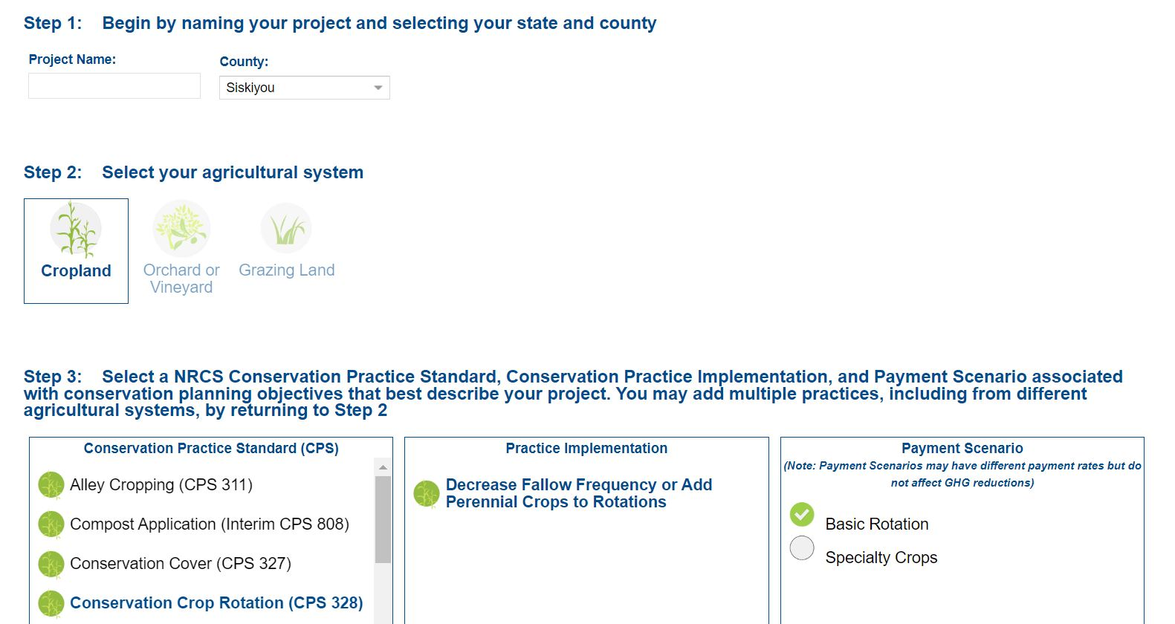
Motivation
Methodology
Learnings

Slide 52

Motivation
Methodology
Learnings

Slide 53
Motivation
Methodology
Learnings
Decrease fallow frequency or add perennial crops to rotations

Slide 54
Motivation
Methodology
Learnings
Sequester carbon and reduce nitrous oxide emissions

